Slide 1

Javascript (Objects)
by
M NAVEENKUMAR
Assistant Professor
Department of Computer Science and Engineering
SRI RAMACHANDRA ENGINEERING AND TECHNOLOGY
Sri Ramachandra Institute of Higher Education and Research

Slide 2
Recall: Javascript - Data types
The values we assign to variables fall under a few distinct data types.
undefined
null
Numbers
Strings
Booleans
Arrays
Object
Primitive
Composite

Slide 3
Objects in Javascript
Recall : Variables are data containers
var car = “maruti”;
Objects are also variables but contain many values.
The values are written as name:value pairs.
var car = {type:"Fiat", model:"500", color:"white"};
A Custom Object
NOTE : objects are containers for named values called properties

Slide 4
Objects in Javascript
var car = {type:"Fiat", model:"500", color:"white"};
var car = {
type : "Fiat", model : "500", color : "white"
};
Object Definition
Object literal notation

Slide 5
Objects Definition
We can define objects in Javascript in following ways
Object literal notation
new keyword
Object literal
new keyword
var person = { firstName: "John", lastName: "Doe", age: 50, eyeColor: "blue" };
var person = new Object(); person.firstName = "John"; person.lastName = "Doe"; person.age = 50; person.eyeColor = "blue";

Slide 6
Accessing Object Properties
You can access object properties in two ways:
objectName.propertyName
or
objectName["propertyName"]

Slide 7
Accessing Object Properties
var person = {firstName:"John", lastName:"Doe", age:50, eyeColor:"blue"};
person.lastName → John //using dot notation
person["lastName"] → John //using bracket notation

Slide 8
Comparing two Objects
Using Reference
Using Data

Slide 9
Comparing two Objects : reference
<script>
// Creating two Objects with same data
object1 = {name: "SRET"};
object2 = {name: "SRET"};
check = (object1 === object2);
console.log(check); // false
// Pointing to the same reference now
object1 = object2;
check = (object1 === object2);
console.log(check); // true
</script>

Slide 10
Comparing two Objects : Data
<script>
// Creating two Objects with same data
object1 = {name: "SRET"};
object2 = {name: "SRET"};
check = (object1 === object2);
console.log(check); // false
str1 = JSON.stringify(object1);
str2 = JSON.stringify(object2);
check = (str1 === str2);
console.log(check); // true
</script>

Slide 11
Challenge
Create an object myObj with three properties prop1, prop2, prop3 with values 10, 20, 30 respectively.
Print myObj to console.
Print prop1, prop2, prop3 values of the Object myObj.

Slide 12
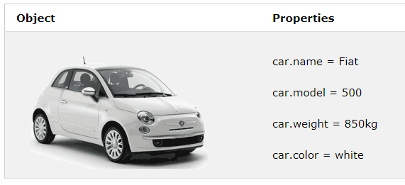
Challenge
Create an object car with the following properties.
Modify property model of object car to 800.
Print modified details of object car to console.

Slide 13
Challenge
Create an empty array myArray
Insert three elements 10, 20, 30 in to the array myArray
Creat an object myObj having two properties prop1, prop2 with values 60, true respectively.
Insert myObj as fourth element of array myArray.

